Slide 1
LESSON 29

Slide 2
Overview
of
Previous Lesson(s)

Slide 3
Over View..
A dependency graph depicts the flow of information among the attribute instances in a particular parse tree.
An edge from one attribute instance to another means that the value of the first is needed to compute the second.
Edges express constraints implied by the semantic rules.
The dependency graph characterizes the possible orders in which we can evaluate the attributes at the various nodes of a parse tree.

Slide 4
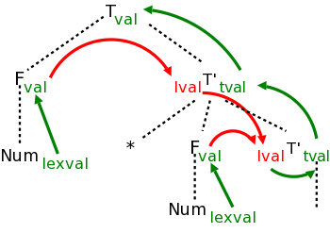
Over View…
The black dotted lines comprise the parse tree for the multiplication grammar just studied when applied to a single multiplication, e.g. 3*5.
Each synthesized attribute is shown in green and is written to the right of the grammar symbol at the node where it is defined.
Each inherited attribute is shown in red and is written to the left of the grammar symbol where it is defined.

Slide 5
Over View…
SDT can be implemented as follows:
Ignoring the actions, parse the input and produce a parse tree as a result.
Then, examine each interior node N, say one for production B → α Add additional children to N for the actions in α so the children of N from left to right have exactly the symbols and actions of α
Perform a preorder traversal of the tree, and as soon as a node labeled by an action is visited, perform that action.

Slide 6
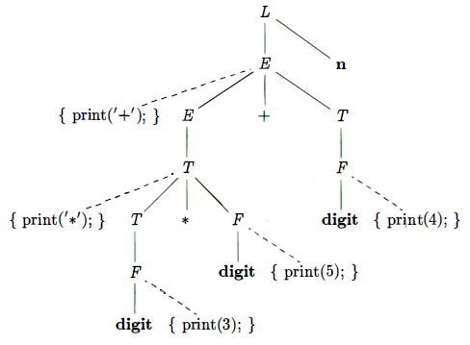
Over View…
It shows the parse tree for expression 3 * 5 + 4 with actions inserted.
Visiting the nodes in preorder, we get the prefix form of the expression: + * 3 5 4.

Slide 7
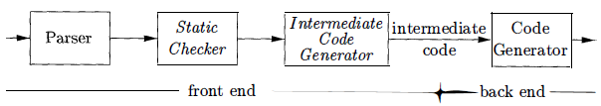
Over View…
In the analysis-synthesis model of a compiler, the front end analyzes a source program and creates an intermediate representation, from which the back end generates target code.
A directed acyclic graph (DAG) for an expression identifies the common sub-expressions of the expression.
It has leaves corresponding to atomic operands and interior codes corresponding to operators.

Slide 8
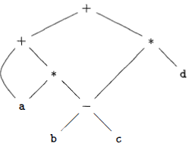
Over View…
A node N in a DAG has more than one parent if N represents a common Sub-expression.
In a syntax tree, the tree for the common sub expression would be replicated as many times as the sub expression appears in the original expression.
Ex. a + a * (b - c) + (b - c) * d
The leaf for a has two parents, because a appears twice in the expression.

Slide 9
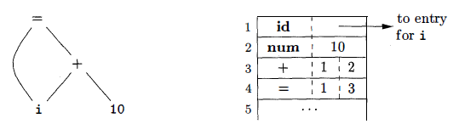
Over View…
The nodes of a syntax tree or DAG are stored in an array of records
DAG for i = i + 10 allocated in an array
Each row of the array represents one record, and therefore one node.
In each record, the first field is an operation code, indicating the label of the node.
In array, leaves have one additional field, which holds the lexical value and interior nodes have two additional fields indicating the left and right children.

Slide 10
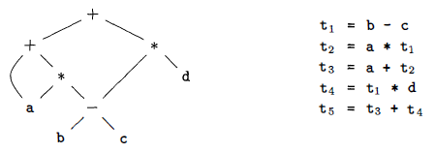
Over View…
Three-address code is a linearized representation of a syntax tree or a DAG in which explicit names correspond to the interior nodes of the graph.

Slide 11
Over View…
An address can be one of the following:
Name For convenience, we allow source-program names to appear as addresses in three-address code. In an implementation, a source name is replaced by a pointer to its symbol-table entry, where all information about the name is kept.
Constant In practice, a compiler must deal with many different types of constants and variables.
Compiler-generated temporary. It is useful, especially in optimizing compilers, to create a distinct name each time a temporary is needed.

Slide 12
Over View…
A quadruple has four fields, known as op, arg₁, arg₂ & result
The op field contains an internal code for the operator.
For instance, the three-address instruction x = y + Z is represented by placing + in op y in arg₁ z in arg₂ and x in result
Some exceptions to this rule are:
Instructions with unary operators like x = minus y or x = y do not use arg₂
Operators like param use neither arg₂ nor result.
Conditional and unconditional jumps put the target label in result.

Slide 13
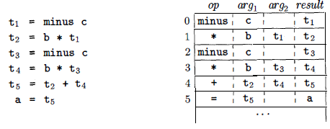
Over View…
Ex: Three-address code for the assignment a = b* - c + b* - c ;
Three Address Code Quadruples

Slide 14
Contents
Three-Address Code
Addresses and Instructions
Quadruples & Triples
Static Single-Assignment Form
Types and Declarations
Type Expressions & Equivalence
Declarations
Storage Layout for Local Names
Sequences of Declarations
Fields in Records and Classes
Translation of Expressions
Operations Within Expressions
Incremental Translation
Addressing Array Elements

Slide 15
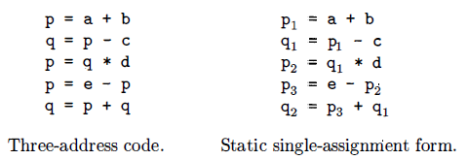
Static Single-Assignment Form
Static single-assignment form (SSA) is an intermediate representation that facilitates certain code optimizations.
All assignments in SSA are to variables with distinct names, hence the term static single-assigment.
A program in three-address code and in static single assignment form.

Slide 16
Types & Declarations
The applications of types can be grouped under checking and translation:
Type checking uses logical rules to reason about the behavior of a program at run time.
Specifically, it ensures that the types of the operands match the type expected by an operator.
Ex, the && operator in Java expects its two operands to be booleans, the result is also of type boolean.

Slide 17
Types & Declarations..
Translation Applications
From the type of a name, a compiler can determine the storage that will be needed for that name at run time.
Type information is also needed to calculate the address denoted by an array reference, to insert explicit type conversions, and to choose the right version of an arithmetic operator, among other things.
The actual storage for a procedure call or an object is allocated at run time, when the procedure is called or the object is created.

Slide 18
Types Expressions
Types have structure, which is represented using type expressions.
A type expression is either a basic type or is formed by applying an operator called a type constructor to a type expression.
The sets of basic types and constructors depend on the language to be checked.
Following definition of type expressions can be used:
A basic type is a type expression. Typical basic types for a language include boolean, char, integer, float and void the latter denotes "the absence of a value."

Slide 19
Types Expressions..
A type name is a type expression.
A type expression can be formed by applying the array type constructor to a number and a type expression.
A record is a data structure with named fields. A type expression can be formed by applying the record type constructor to the field names and their types.
A type expression can be formed by using the type constructor → for function types. We write s → t for function from type s to type t

Slide 20
Types Expressions…
If s and t are type expressions, then their Cartesian product s x t is a type expression. Products are introduced for completeness. They can be used to represent a list or tuple of types i.e for function parameters.
Type expressions may contain variables whose values are type expressions.

Slide 21
Types Equivalence
When are two type expressions equivalent.?
Many type-checking rules have the form if two type expressions are equal then return a certain type else error
Potential ambiguities arise when names are given to type expressions and the names are then used in subsequent type expressions.
The key issue is whether a name in a type expression stands for itself or whether it is an abbreviation for another type expression.

Slide 22
Types Equivalence..
When type expressions are represented by graphs, two types are structurally equivalent if and only if one of the following conditions is true:
They are the same basic type.
They are formed by applying the same constructor to structurally equivalent types.
One is a type name that denotes the other .

Slide 23
Storage Layout for Local Names
Amount of storage that will be needed for the name at run time can be determined from the type of a name.
At compile time, we can use these amounts to assign each name a relative address.
The type and relative address are saved in the symbol-table entry for the name
Data of varying length, such as strings, or data whose size cannot be determined until run time, such as dynamic arrays, is handled by reserving a known fixed amount of storage for a pointer to the data

Slide 24
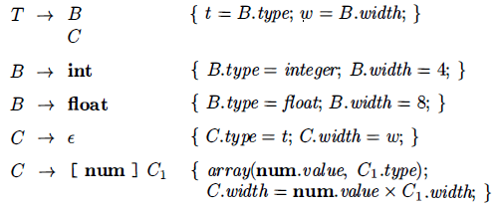
Storage Layout for Local Names..
This translation scheme computes types and their widths for basic and array types.
It uses synthesized attributes type and width for each non-terminal and two variables t and w to pass type and width information from a B node in a parse tree to the node for the production C → ɛ
In a syntax-directed definition t and w would be inherited attributes for C

Slide 25
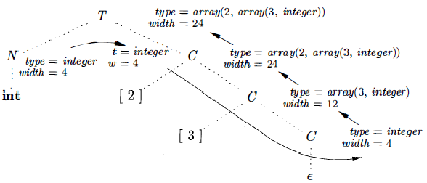
Storage Layout for Local Names..
The parse tree for the type int[2][3] is shown by dotted lines.
The solid lines show how the type and width are passed from B, down the chain of C's through variables t and w, and then back up the chain as synthesized attributes type and width.
The variables t and w are assigned the values of B.type and B.width respectively, before the subtree with the C nodes is examined.

Slide 26
Sequences of Declarations
Languages such as C and Java allow all the declarations in a single procedure to be processed as a group.
The declarations may be distributed within a Java procedure but they can still be processed when the procedure is analyzed.
We can use a variable, say offset, to keep track of the next available relative address.

Slide 27
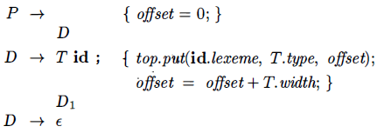
Sequences of Declarations..
This translation scheme deals with a sequence of declarations of the form T id, where T generates a type.
Before the first declaration is considered, offset is set to 0
As each new name x is seen, x is entered into the symbol table with its relative address set to the current value of offset, which is then incremented by the width of the type of x.

Slide 28
Sequences of Declarations…
The semantic action within the production D → T id, D₁ creates a symbol table entry by executing top.put(id. lexeme, T. type, offset)
top denotes the current symbol table.
The method top.put creates a symbol-table entry for id.lexeme, with type T.type and relative address offset in its data area.
The initialization of offset is more evident if the first production appears on one line as:
p → { offset = 0; } D

Slide 29
Fields in Records and Classes
The translation of declarations carries over to fields in records and classes.
Record types can be added to the following grammar by adding the following production.
T → record ' {' D '}'

Slide 30
Fields in Records and Classes
The fields in this record type are specified by the sequence of declarations generated by D.
The approach used for computing the relative addresses of declared names can be used to determine the types and relative addresses of fields, provided we are careful about two things:
The field names within a record must be distinct, i.e a name may appear at most once in the declarations generated by D .
The offset or relative address for a field name is relative to the data area for that record.

Slide 31
Translation of Expressions
In this section we will see different methods of the translation of expressions into three-address code.
An expression with more than one operator, like a + b * c, will translate into instructions with at most one operator per instruction.
An array reference A[i][j] will expand into a sequence of three-address instructions that calculate an address for the reference.

Slide 32
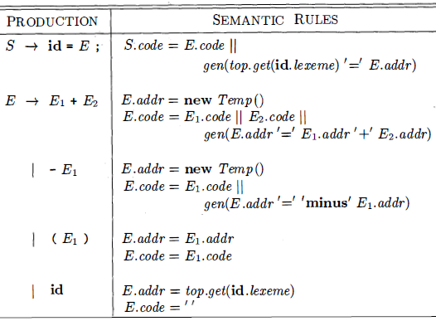
Operations within Expressions
This SDD builds up the three-address code for an assignment statement S using attribute code for S & attributes addr & code for an expression E
Attributes S. code and E.code denote the three-address code for S and E respectively.
Attribute E.addr denotes the address that will hold the value of E.

Slide 33
Operations within Expressions..
Ex. Using this syntax- directed definition,
assignment statement a = b + - c
is translated into the three-address code sequence
t₁ = minus c
t₂ = b + t₁
a = t₂

Slide 34
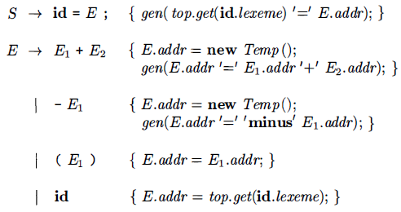
Incremental Translation
Code attributes can be long strings, so they are usually generated incrementally.
So we can generate only the new three-address instructions as:
In the incremental approach, gen not only constructs a three-address instruction, it appends the instruction to the sequence of instructions generated so far.
The sequence may either be retained in memory for further processing, or it may be output incrementally.

Slide 35
Thank You

